Slide 1
Tutorial 1 Extra Notes
How to OOP

Slide 2
Aims of OOP
Easy to add new features
Break code into more manageable chunks (more on this during next week’s tutorial)
Increase reusability

Slide 3
Scenario
Want to simulate life
Plants and Animals

Slide 4
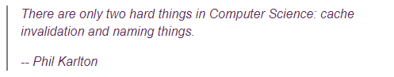
Names
Think very hard about names
Names of classes, variables, and methods
In 6 months time, can you understand your own code easily?

Slide 5
First Step: Identify Nouns
Plants and Animals

Slide 6
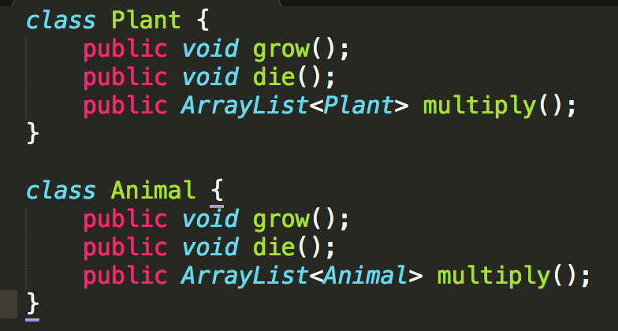
Create classes

Slide 7
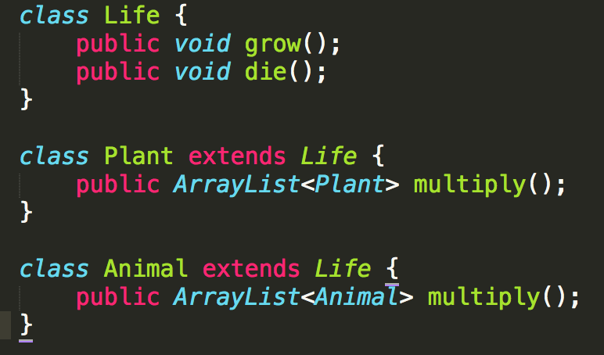
Combine common elements
D.R.Y. (Don’t Repeat Yourself)

Slide 8
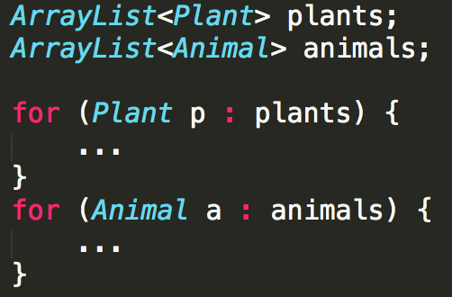
(Possible) Main Program Loop

Slide 9
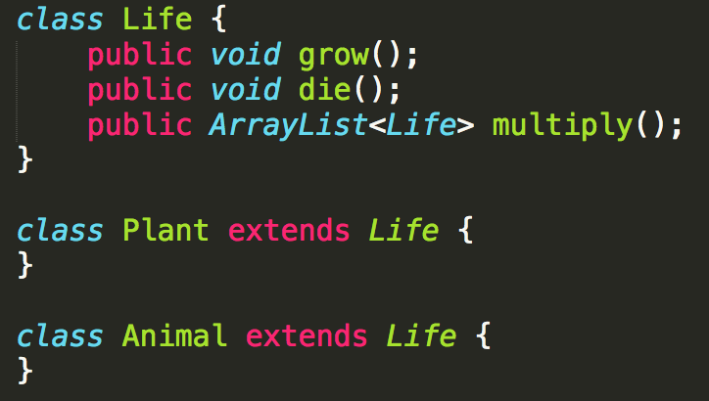
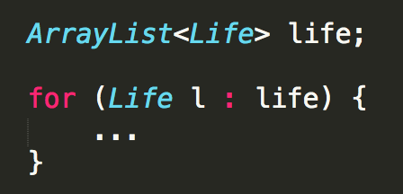
We can do better
Use inheritance to make things easier

Slide 10
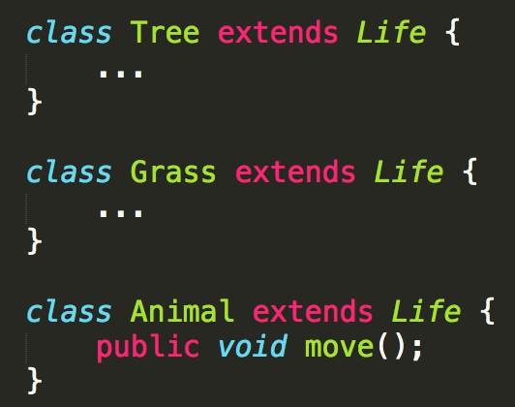
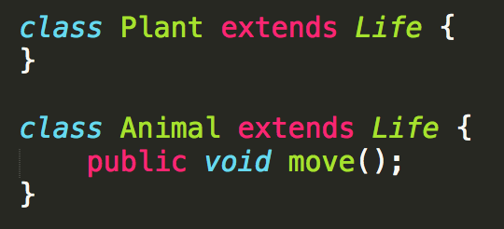
Add more methods
It is okay to have classes that have no difference from their parents
vs
Plan ahead, do work now to avoid more work later
╳
✔
Notes:
Example: Want to add plant-only methods in the future

Slide 11
Class Diagram
Life
Animal
Plant

Slide 12
New Feature
Want to simulate immortal life (i.e. God, i.e. )
How to model?
https://www.reddit.com/r/onetruegod/

Slide 13
Class Diagram
Maybe?
Life
Animal
Plant

Slide 14
Class Diagram
Maybe?
Life
ImmortalLife
Animal
Plant

Slide 15
Class Diagram
Life
Actually…
MortalLife
Animal
Plant

Slide 16
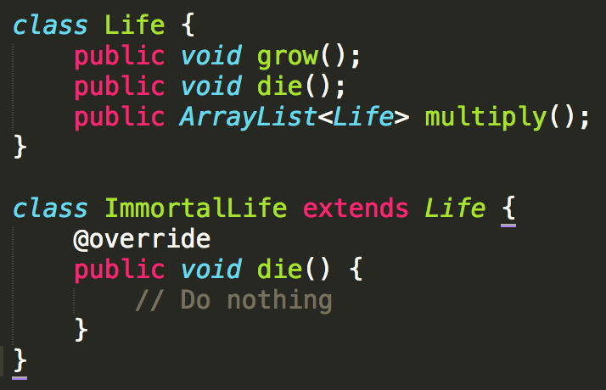
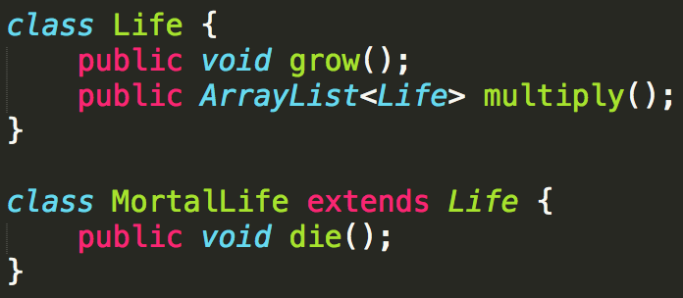
Why?
\
vs
“Child” classes must have the same functionality as their parents
They can have more functions or do things differently, but the method must still do as described

Slide 17
When are interfaces & abstract classes used?
Add functionality with different implementations to classes
Common use case: Want to log all actions to a text file

Slide 18
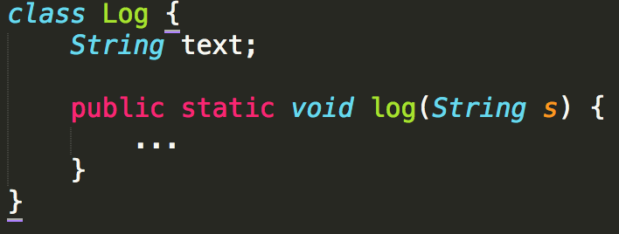
Class Diagram
Life
How to identify each object?
MortalLife
Animal
Plant
Log.log()
Log.log()
Log.log()
Log.log()
Log.log()
Log.log()
Log
Notes:
Your first intuition would probably to have a log class as and when needed

Slide 19
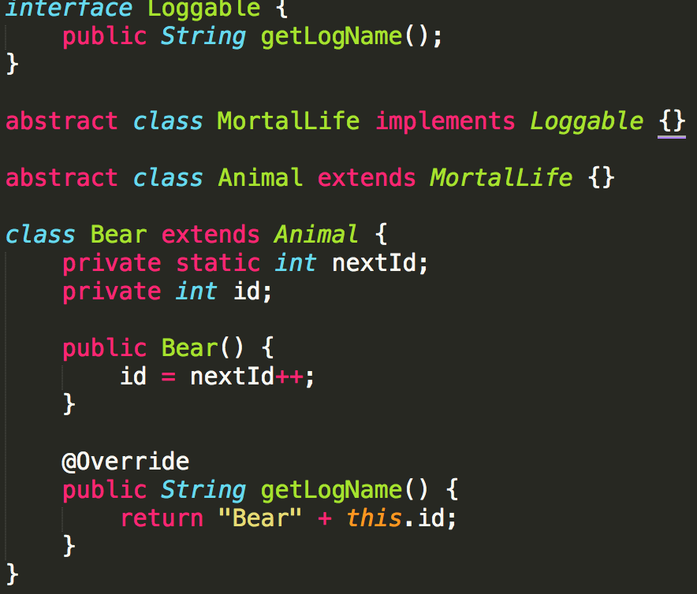
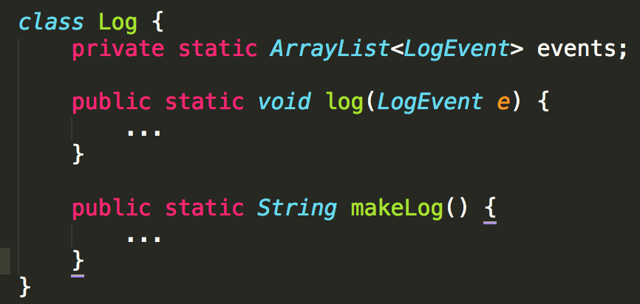
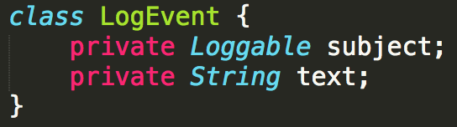
Class Diagram
Life
implements Loggable
MortalLife
Animal
Plant
Log.log()
Log.log()
Log.log()
Log.log()
Log.log()
Log
Notes:
Abstract classes allow interface implementations to be deferred to children
Interfaces force classes to implement certain functionality
Interfaces allow other classes to be sure that a class implements something

